Slide 1
Proxy Pattern
Ever play good cop, bad cop? You’re the good cop and you provide all your services in a nice and friendly manner, but you don’t want everyone asking you for services, so you have the bad cop control access to you. That’s what proxies do: control and manage access. As you’re going to see, there are lots of ways in which proxies stand in for the objects they proxy. Proxies have been known to haul entire method calls over the Internet for their proxied objects; they’ve also been known to patiently stand in the place for some pretty lazy objects.
Use the Proxy Pattern to create a representative object that controls access to another object, which may be remote, expensive to create, or in need of securing.
The Proxy Pattern provides a surrogate or placeholder for another object to control access to it.
As we know,
A remote proxy controls access to a remote object.
A virtual proxy controls access to resource that is expensive to create.
A protection proxy controls access to a resource based on access rights.

Slide 2
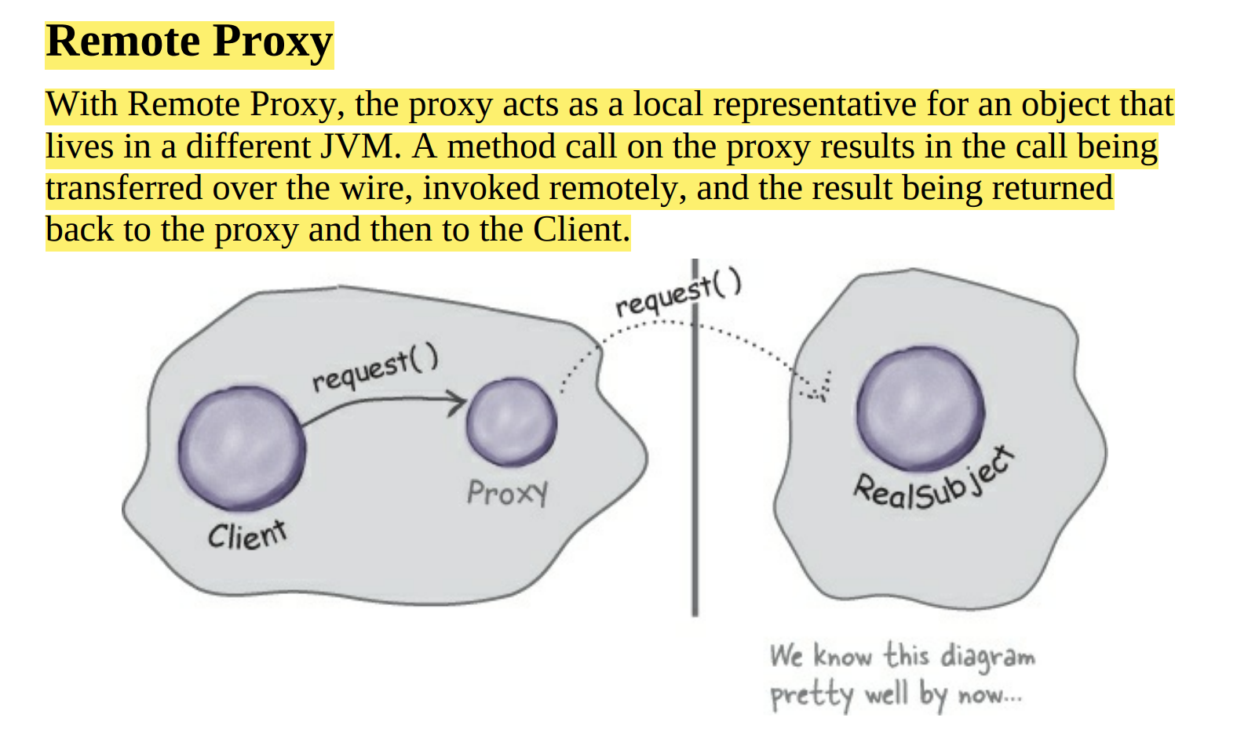
1. Remote Proxy

Slide 3
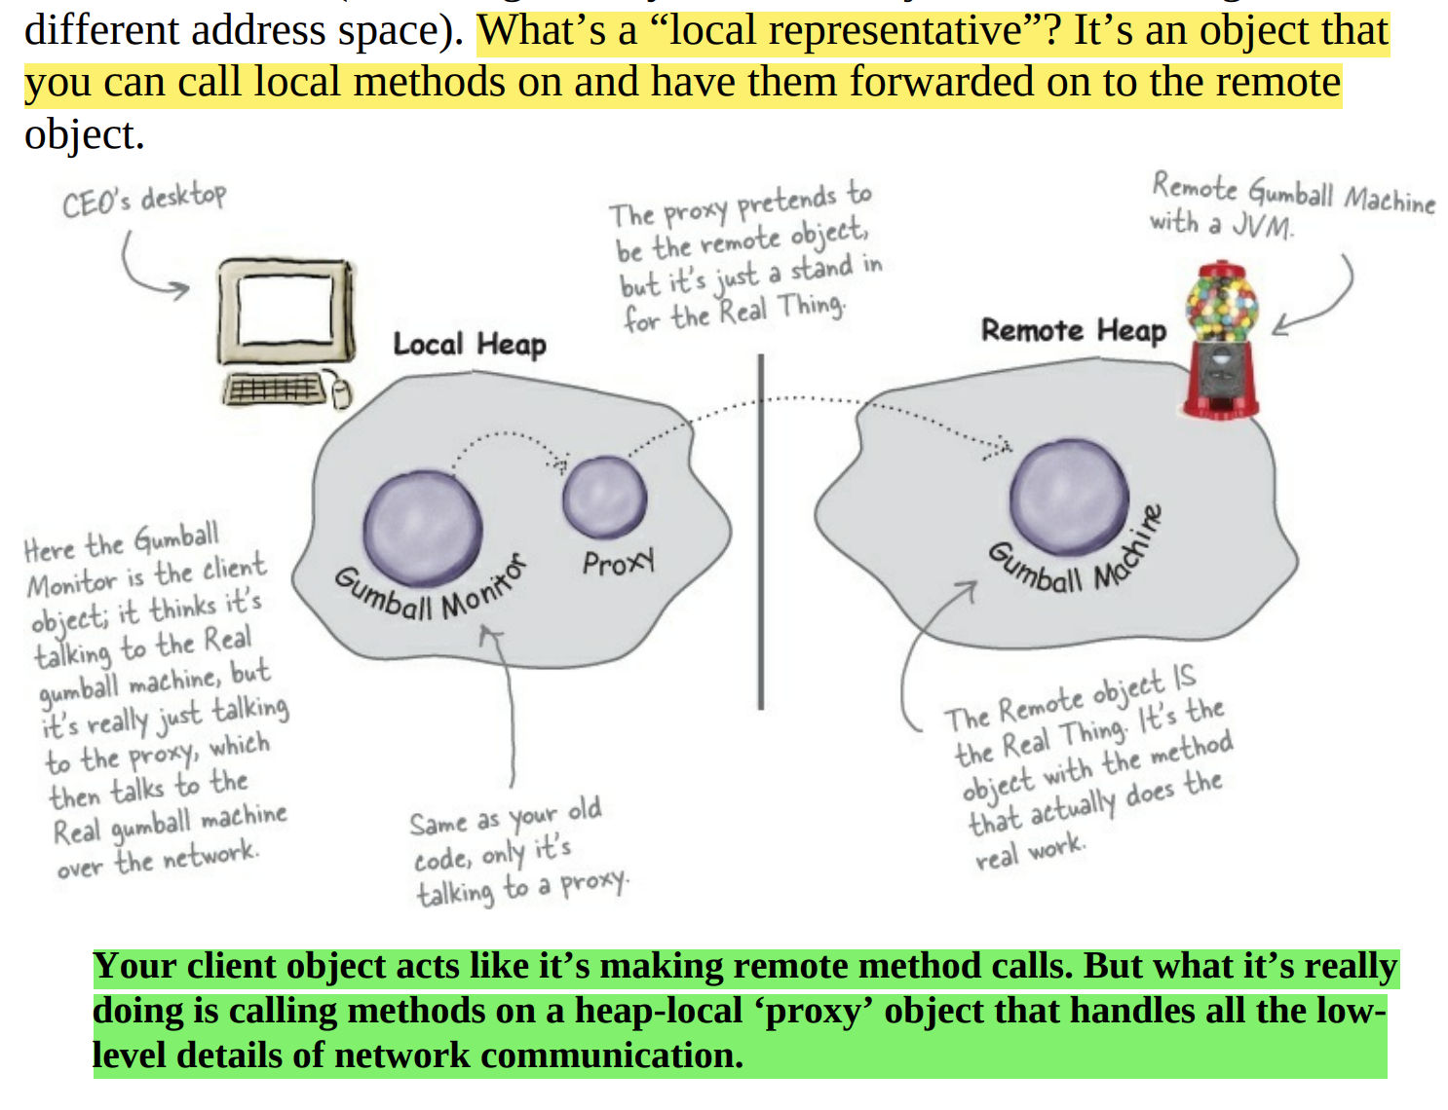

Slide 4
AN RMI Detour
Let’s say we want to design a system that allows us to call a local object that forwards each request to a remote object. How would we design it? We’d need a couple of helper objects that actually do the communicating for us. The helpers make it possible for the client to act as though it’s calling a method on a local object (which in fact, it is). The client calls a method on the client helper, as if the client helper were the actual service. The client helper then takes care of forwarding that request for us. In other words, the client object thinks it’s calling a method on the remote service, because the client helper is pretending to be the service object. Pretending to be the thing with the method the client wants to call. But the client helper isn’t really the remote service. Although the client helper acts like it (because it has the same method that the service is advertising), the client helper doesn’t have any of the actual method logic the client is expecting. Instead, the client helper contacts the server, transfers information about the method call (e.g., name of the method, arguments, etc.), and waits for a return from the server. On the server side, the service helper receives the request from the client helper (through a Socket connection), unpacks the information about the call, and then invokes the real method on the real service object. So, to the service object, the call is local. It’s coming from the service helper, not a remote client. The service helper gets the return value from the service, packs it up, and ships it back (over a Socket’s output stream) to the client helper. The client helper unpacks the information and returns the value to the client object.

Slide 5
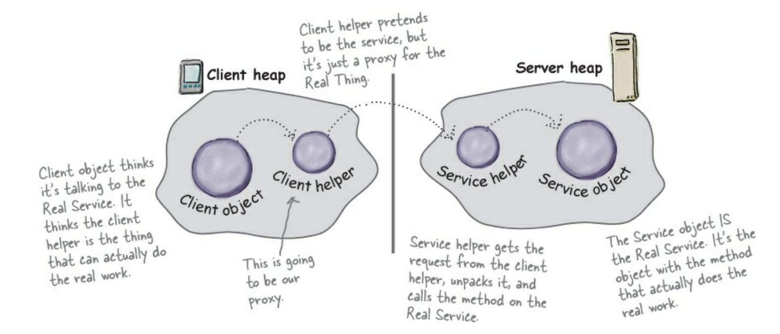

Slide 6
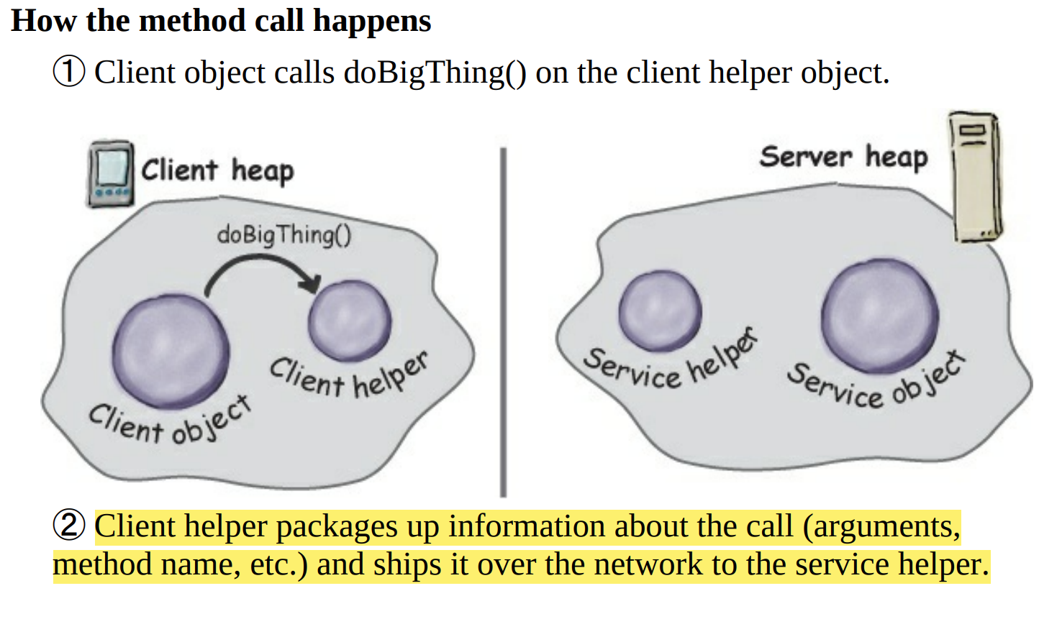

Slide 7
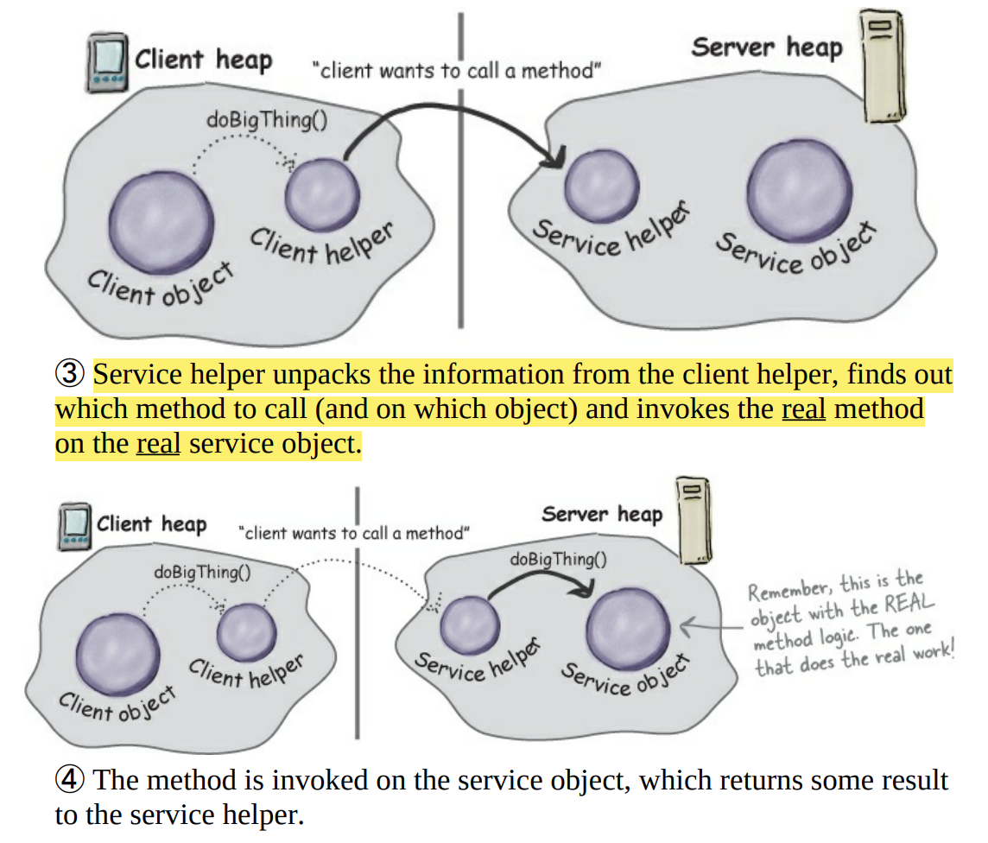

Slide 8
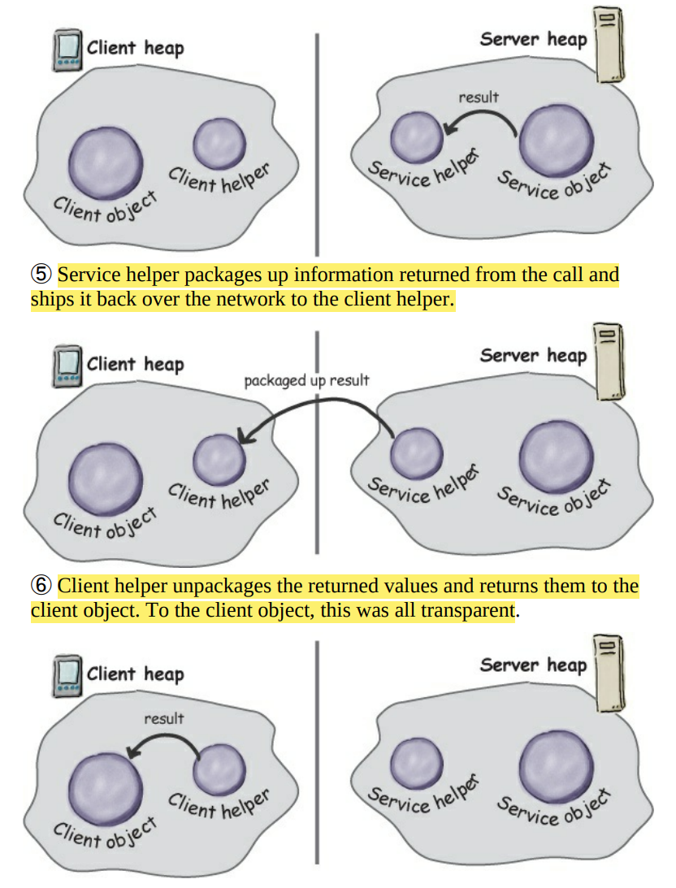

Slide 9
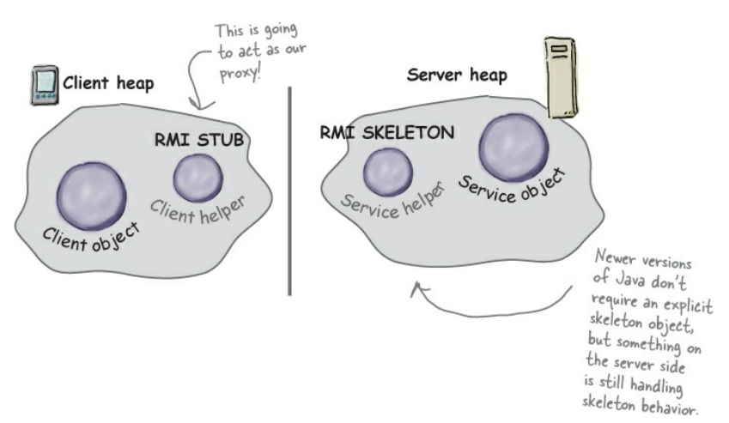

Slide 10
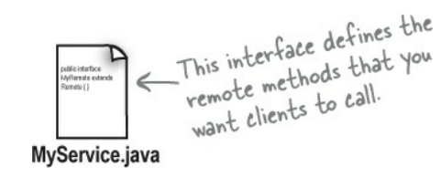
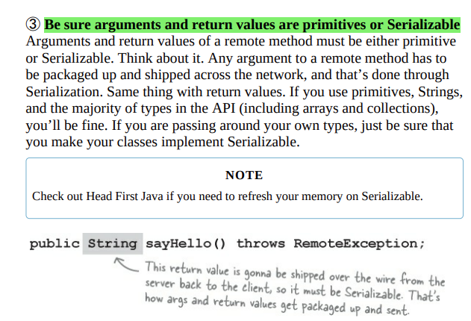
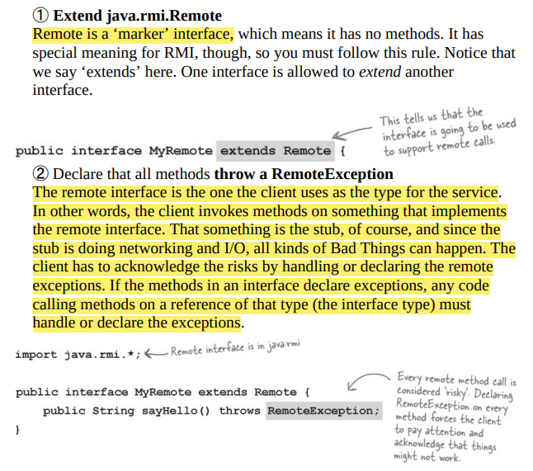
Making the Remote Service
Step one:
Make a Remote Interface The remote interface defines the methods that a client can call remotely. It’s what the client will use as the class type for your service. Both the Stub and actual service will implement this!

Slide 11
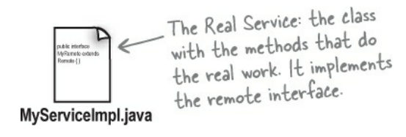
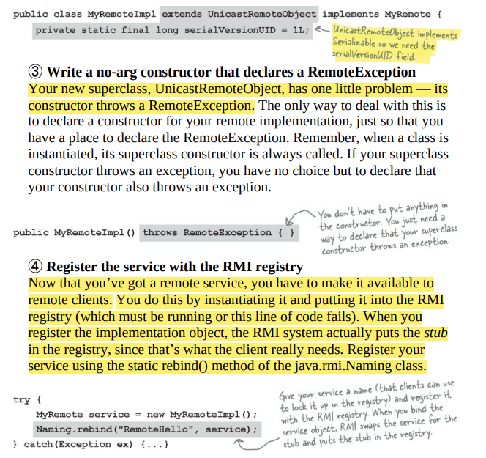
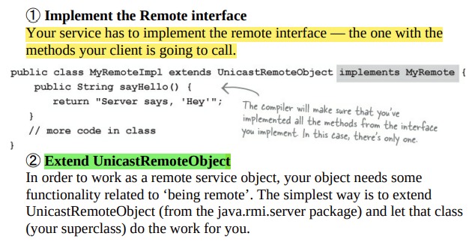
Step two:
Make a Remote Implementation This is the class that does the Real Work. It has the real implementation of the remote methods defined in the remote interface. It’s the object that the client wants to call methods on (e.g., our GumballMachine!).

Slide 12
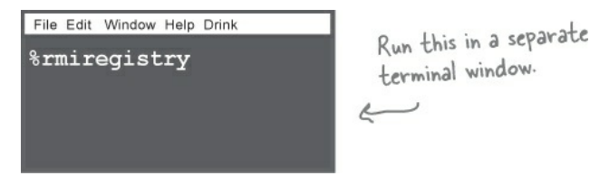
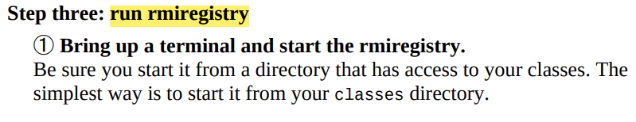
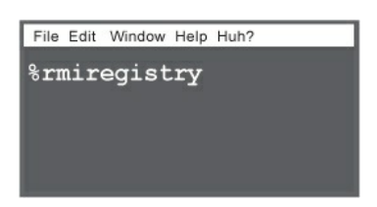
Step three:
Start the RMI registry (rmiregistry) The rmiregistry is like the white pages of a phone book. It’s where the client goes to get the proxy (the client stub/helper object).

Slide 13
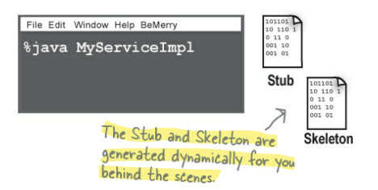
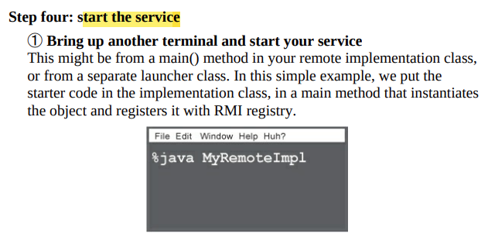
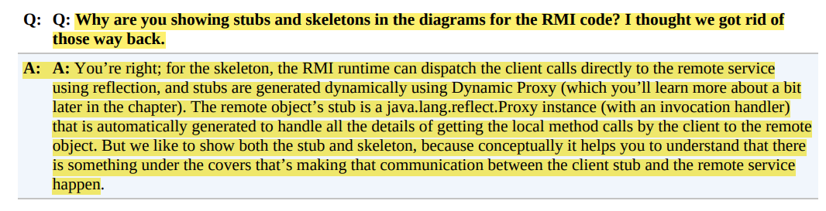
Step four:
Start the remote service You have to get the service object up and running. Your service implementation class instantiates an instance of the service and registers it with the RMI registry. Registering it makes the service available for clients.

Slide 14
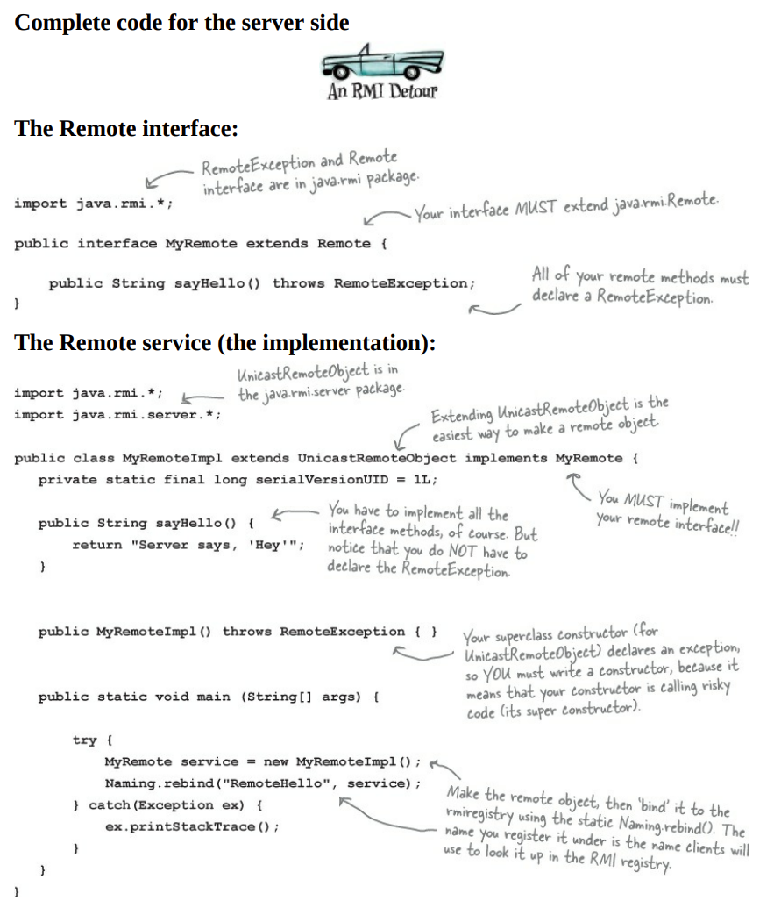

Slide 15
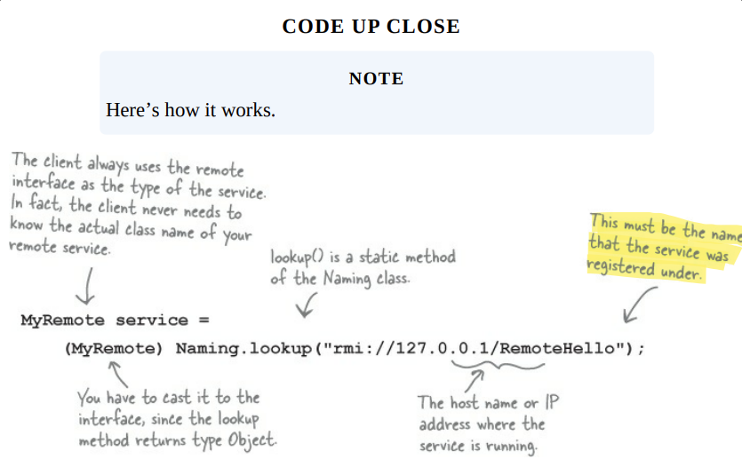
How does the client get the stub object?
The client has to get the stub object (our proxy), since that’s the thing the client will call methods on. And that’s where the RMI registry comes in. The client does a ‘lookup’, like going to the white pages of a phone book, and essentially says, “Here’s a name, and I’d like the stub that goes with that name.” Let’s take a look at the code we need to look-up and retrieve a stub object.

Slide 16
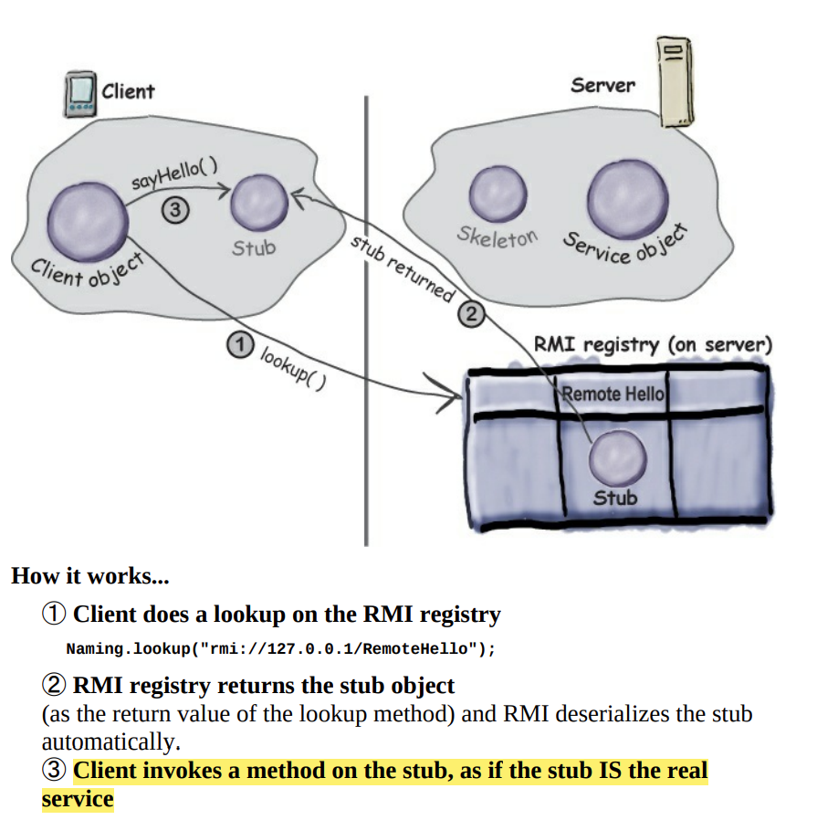

Slide 17
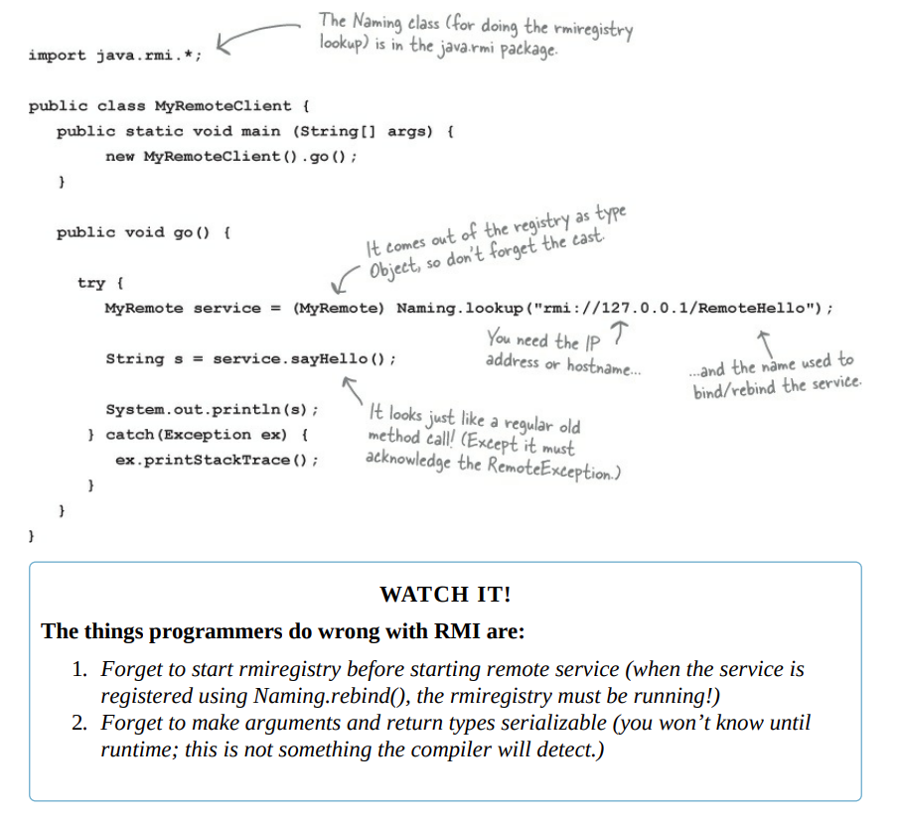
Complete client code

Slide 18
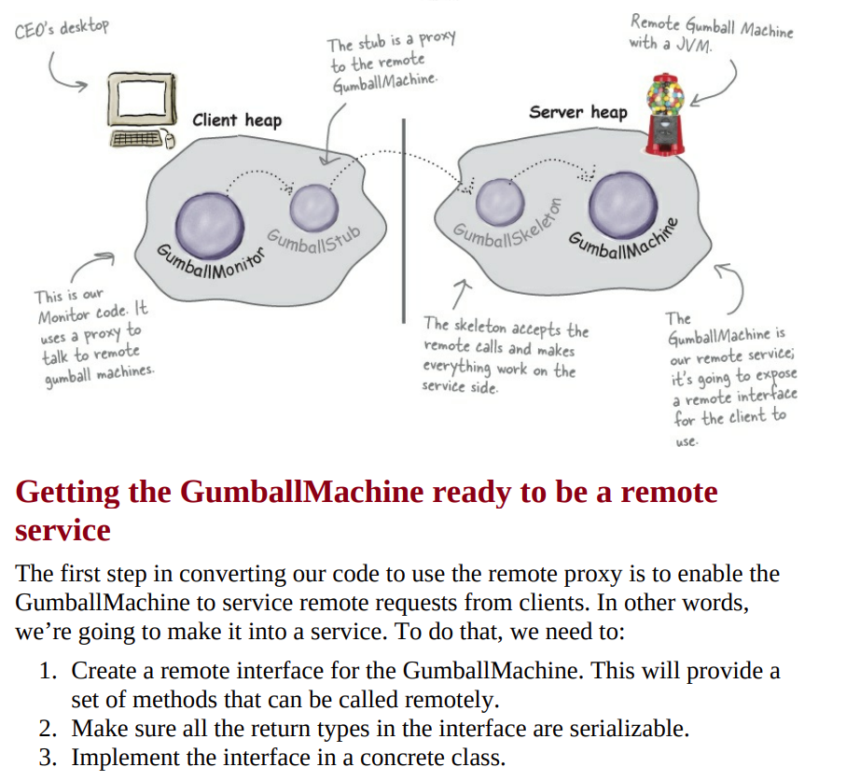
Getting the GumballMachine ready to be a remote service

Slide 19
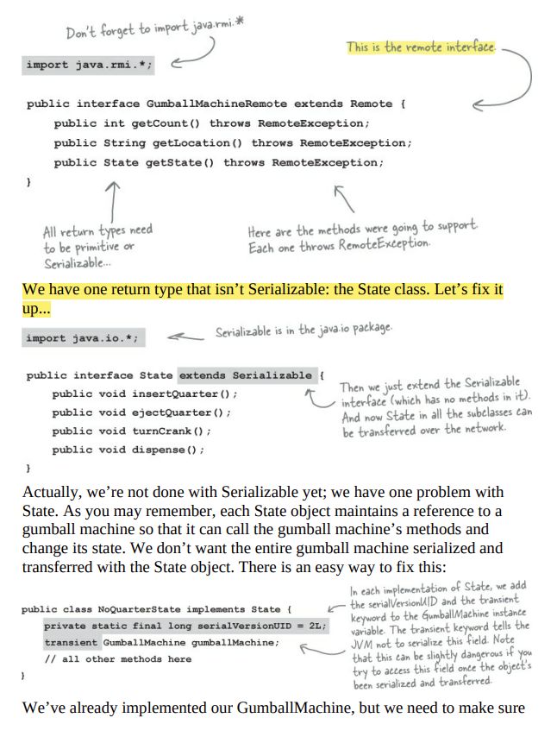
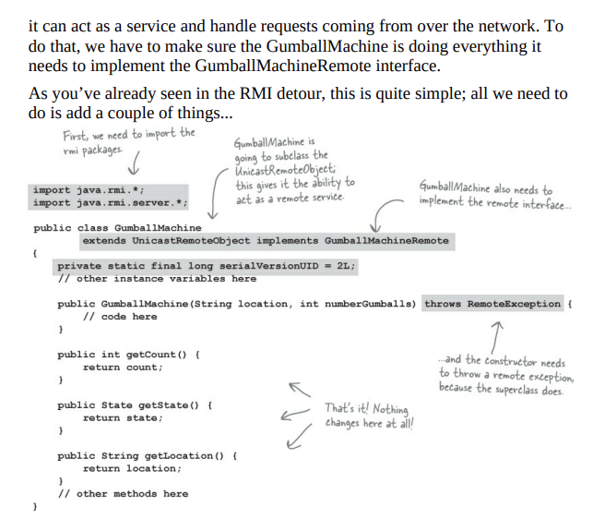
We’ll start with the remote interface

Slide 20
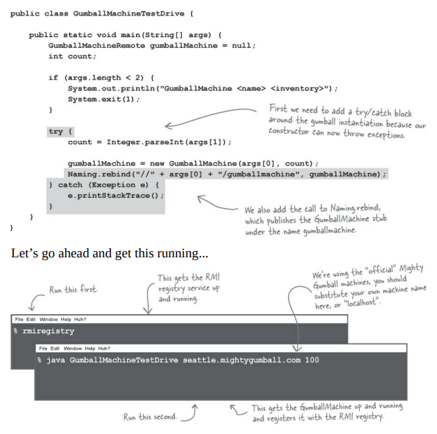
Registering with the RMI registry...
That completes the gumball machine service. Now we just need to fire it up so it can receive requests. First, we need to make sure we register it with the RMI registry so that clients can locate it. We’re going to add a little code to the test drive that will take care of this for us:

Slide 21
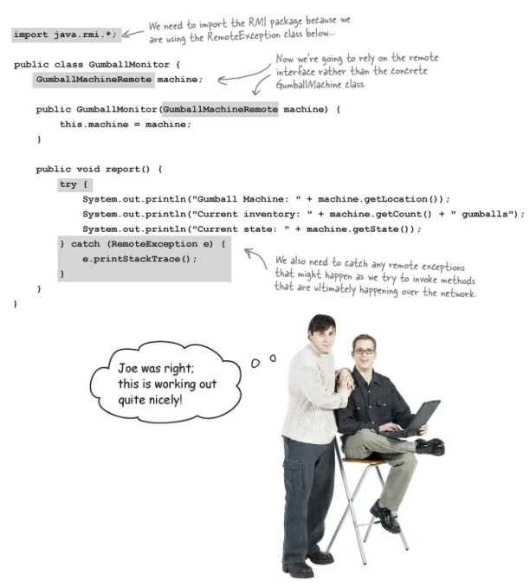
Now for the GumballMonitor client...
Remember the GumballMonitor? We wanted to reuse it without having to rewrite it to work over a network. Well, we’re pretty much going to do that, but we do need to make a few changes.

Slide 22
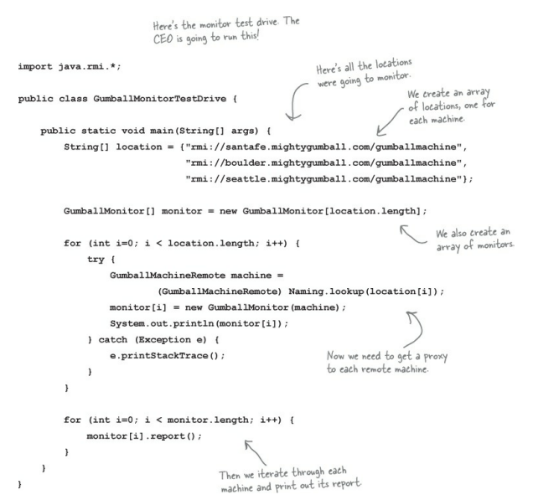
Writing the Monitor test drive
Now we’ve got all the pieces we need. We just need to write some code so the CEO can monitor a bunch of gumball machines:

Slide 23
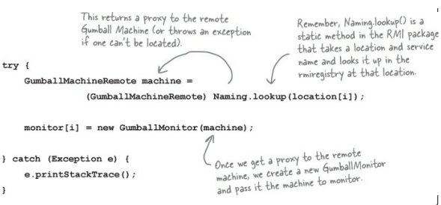
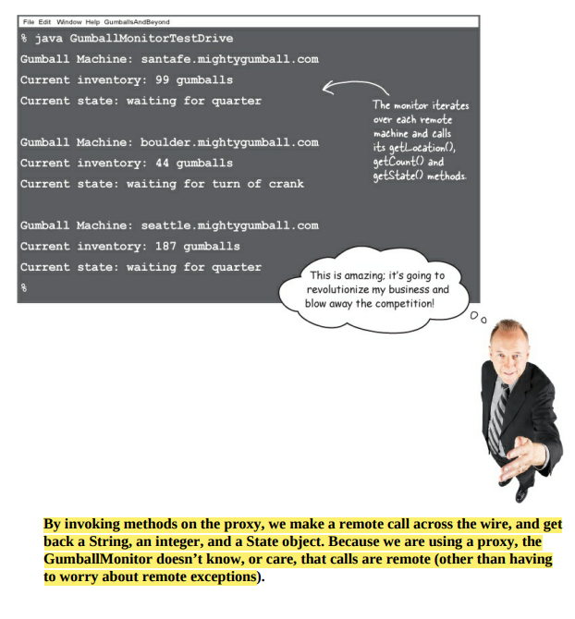
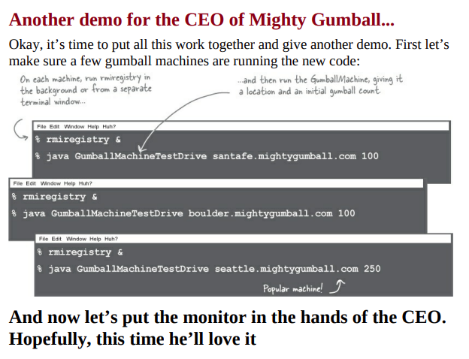
Code up close

Slide 24
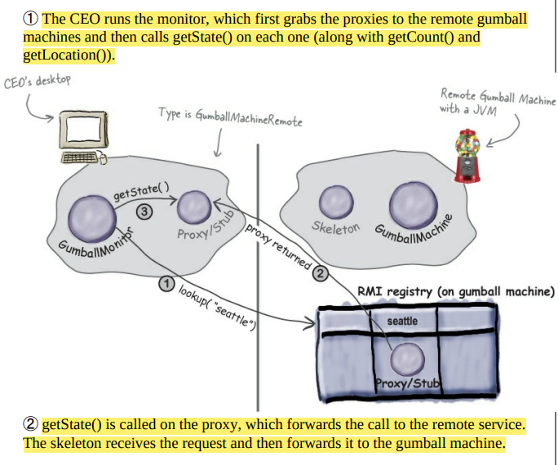
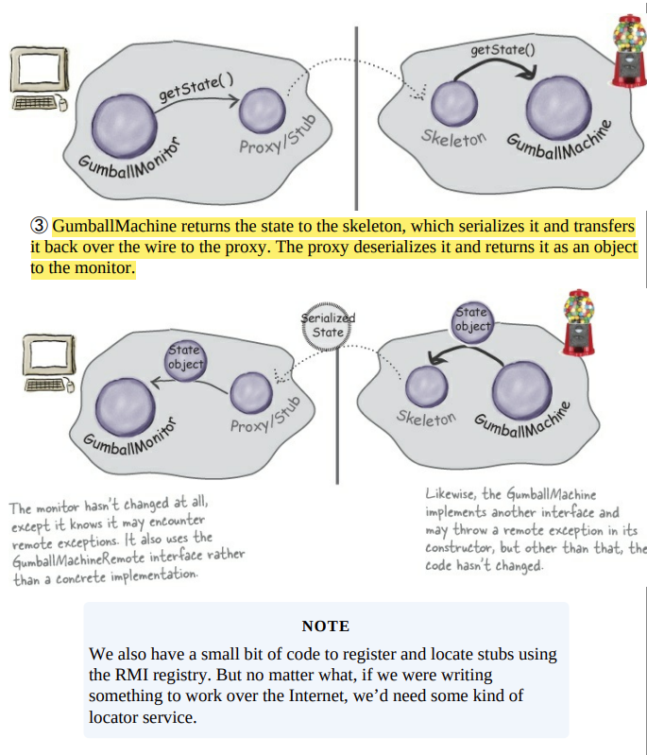
Behind the Scenes

Slide 25
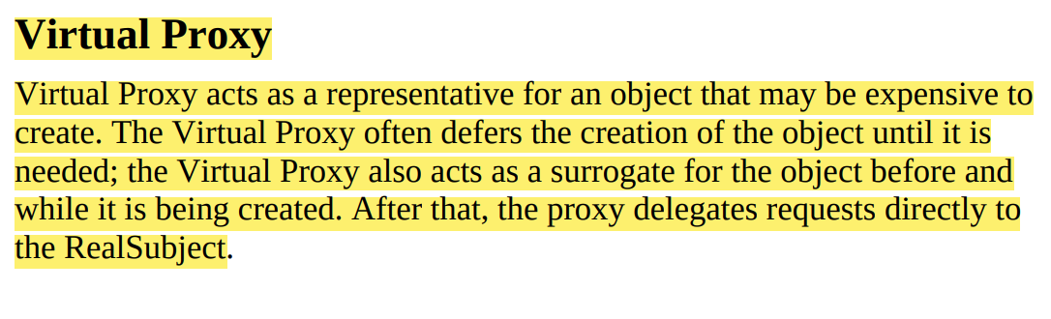
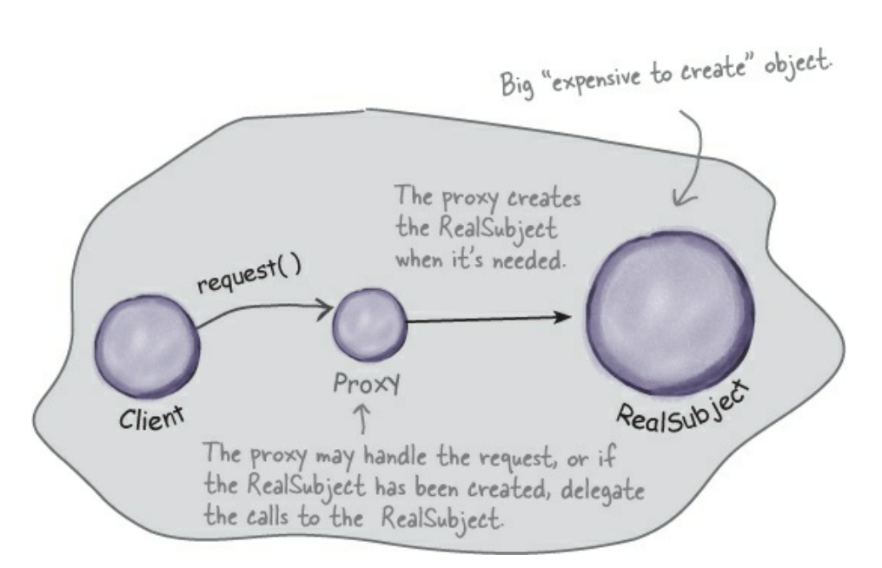
2. Virtual Proxy

Slide 26
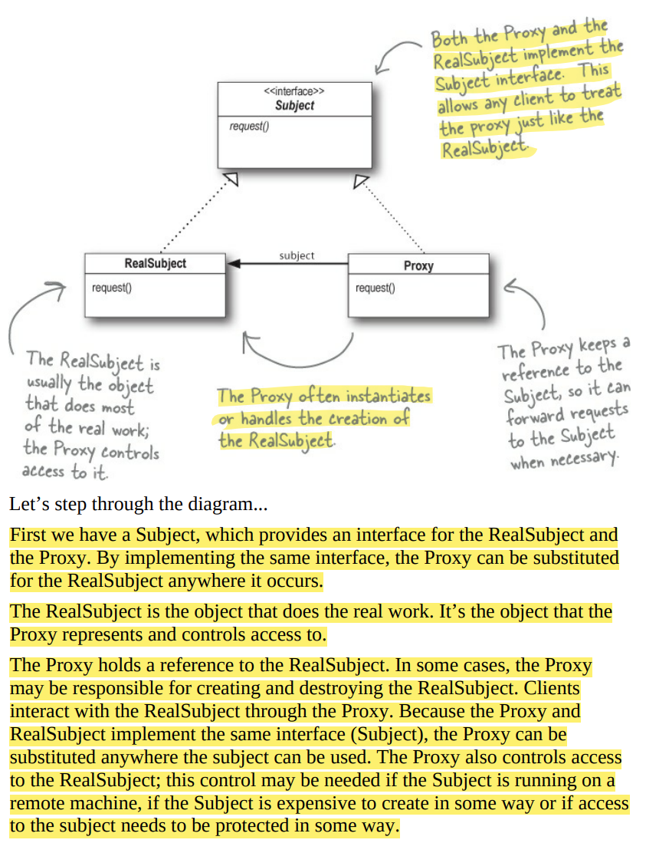

Slide 27
Displaying CD covers
Let’s say you want to write an application that displays your favorite compact disc covers. You might create a menu of the CD titles and then retrieve the images from an online service like Amazon.com. If you’re using Swing, you might create an Icon and ask it to load the image from the network. The only problem is, depending on the network load and the bandwidth of your connection, retrieving a CD cover might take a little time, so your application should display something while you are waiting for the image to load. We also don’t want to hang up the entire application while it’s waiting on the image. Once the image is loaded, the message should go away and you should see the image. An easy way to achieve this is through a virtual proxy. The virtual proxy can stand in place of the icon, manage the background loading, and before the image is fully retrieved from the network, display “Loading CD cover, please wait...”. Once the image is loaded, the proxy delegates the display to the Icon.

Slide 28
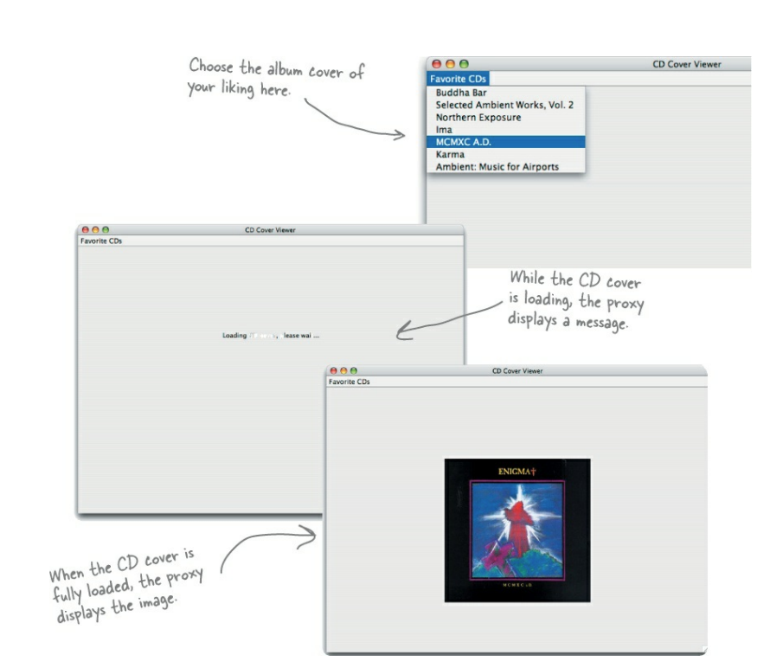

Slide 29
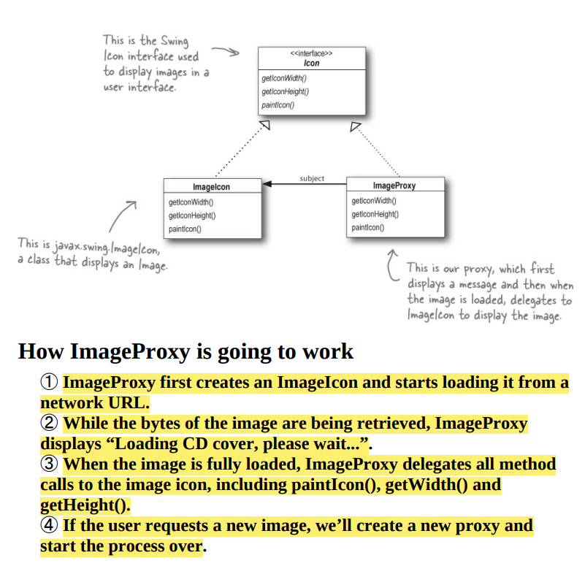
Designing the CD cover Virtual Proxy
Before writing the code for the CD Cover Viewer, let’s look at the class diagram. You’ll see this looks just like our Remote Proxy class diagram, but here the proxy is used to hide an object that is expensive to create (because we need to retrieve the data for the Icon over the network) as opposed to an object that actually lives somewhere else on the network.

Slide 30
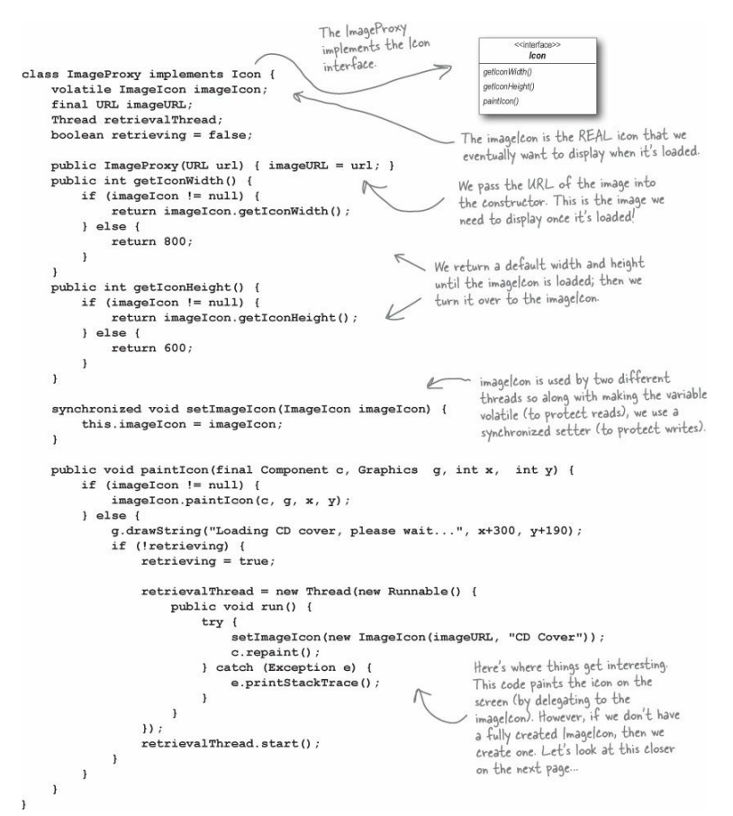
Writing the Image Proxy

Slide 31
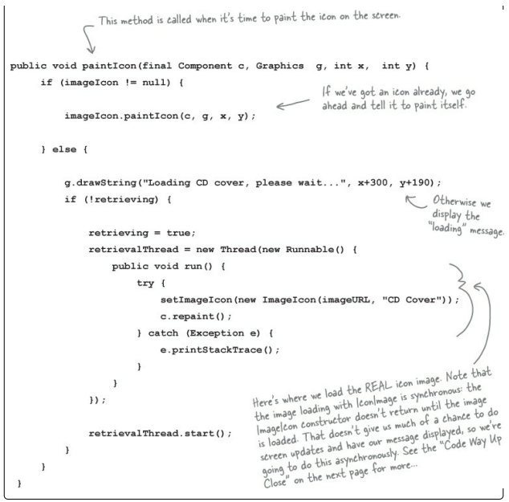
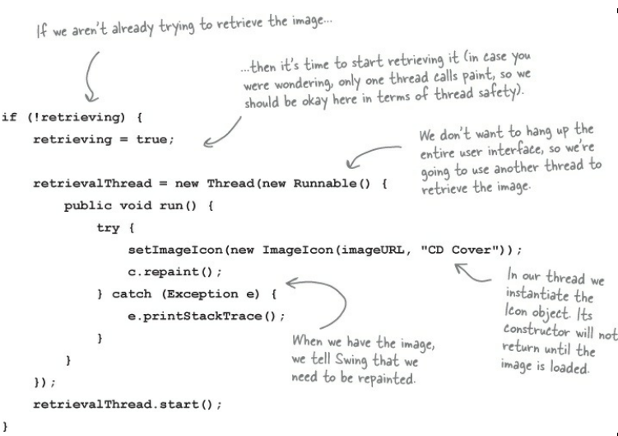
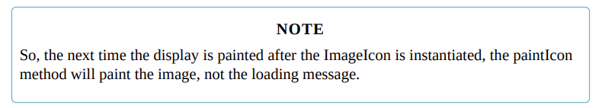

Slide 32
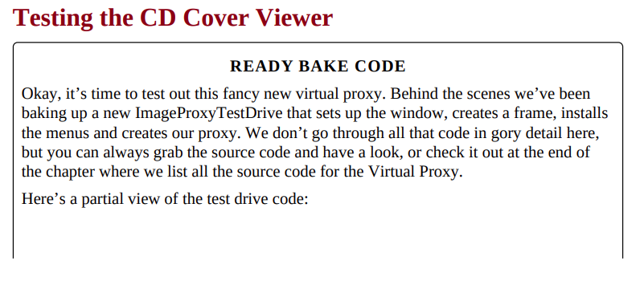
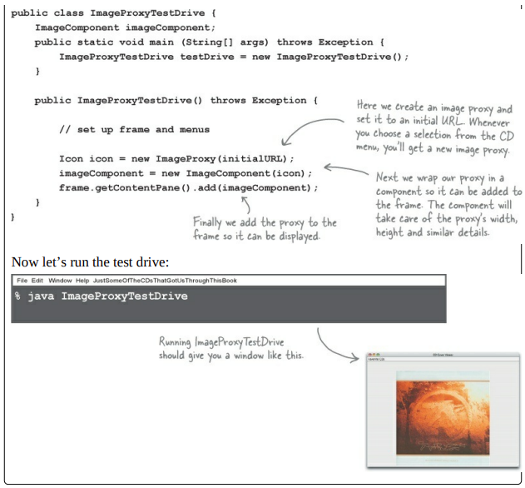

Slide 33
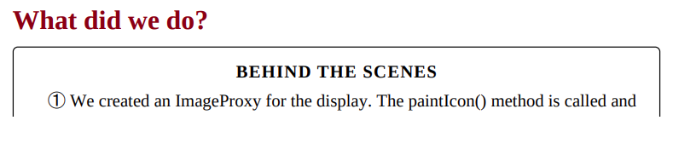
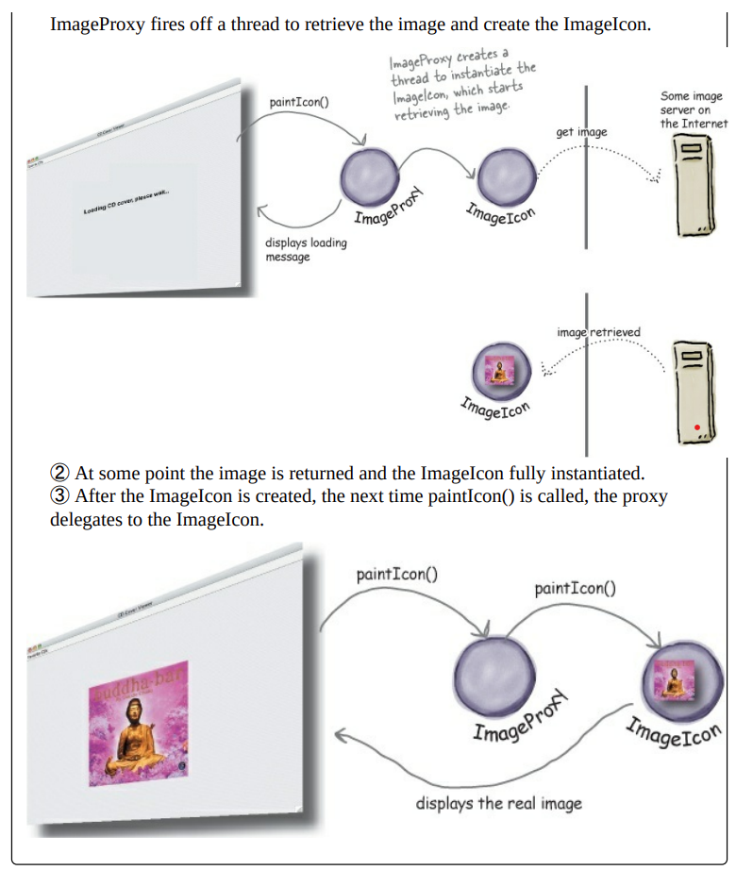

Slide 34
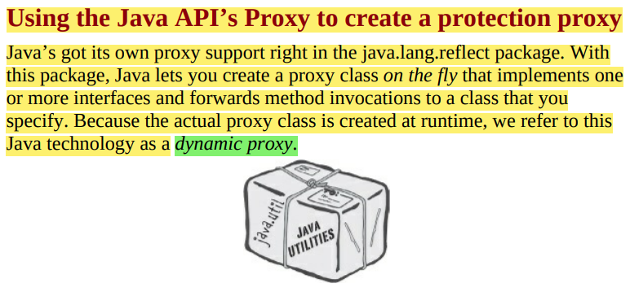
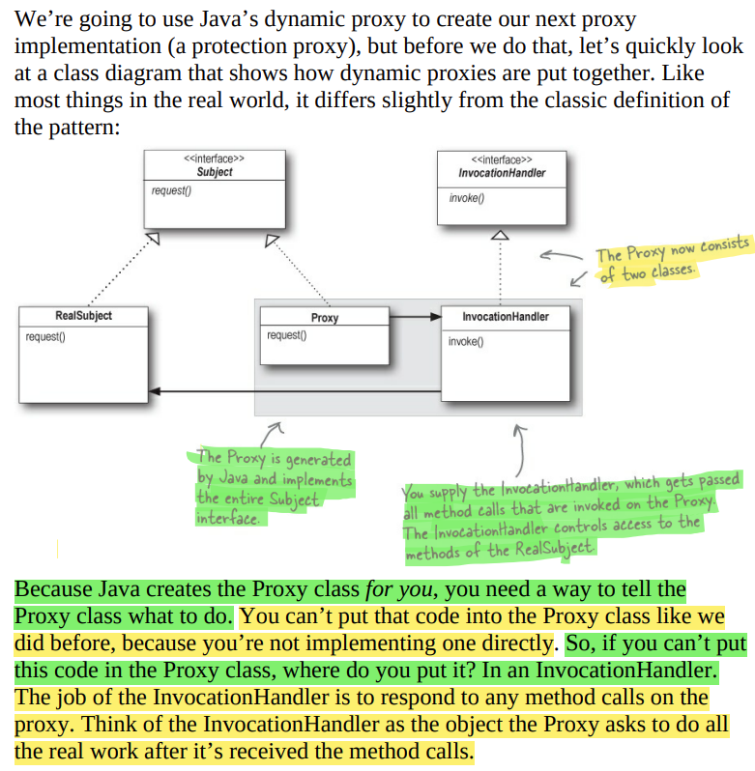
3. Protection Proxy
A protection proxy controls access to a resource based on access rights.

Slide 35
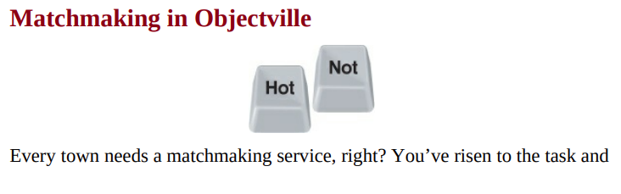


Slide 36



Slide 37




Slide 38



Slide 39



Step one:
Create two InvocationHandlers. InvocationHandlers implement the behavior of the proxy. As you’ll see, Java will take care of creating the actual proxy class and object; we just need to supply a handler that knows what to do when a method is called on it.

Slide 40


Step two:
Write the code that creates the dynamic proxies. We need to write a little bit of code to generate the proxy class and instantiate it. We’ll step through this code in just a bit.

Slide 41




Step three:
Wrap any PersonBean object with the appropriate proxy. When we need to use a PersonBean object, either it’s the object of the customer himself (in that case, will call him the “owner”), or it’s another user of the service that the customer is checking out (in that case we’ll call him “non-owner”). In either case, we create the appropriate proxy for the PersonBean.

Slide 42



Slide 43



Slide 44


